Slide 1

Sync+ 2.0
CDX706L–Desay_EESE&CVPP parts
China EESE&CVPP
Updated on 2022-08-07
Desired Outcome
Awareness
Decision
Escalation Help
Think
Point of view
Plan to Implement
Implement

Slide 2
{R06 PRO.HF3} Software overall status {yellow}
Software key info
  Refer SWAD for the details:
    MCU version:20220725_498_PRO
    SoC version:20220804_0757_GF13_R06.PRO.HF3_Debug
    Verification scope and method:
    {Full verification} executed with pass rate 96%, 0P1 and 32P2 issues found and not fixed. Refer test report for detail.
Highlights listed below:
    Open P2 issue list with risk evaluation – refer slide 4
    Performance Status– refer slide 5/6
    OTA Status– refer slide 7
Notes:
Add P1 weekly burn down chart

Slide 3
{R06 PRO.HF3} 性能修改点
序号 | ID | 描述 | 验证结果 | Comment
1 |  | Baidu APK更新
Notes:
Add P1 weekly burn down chart

Slide 4
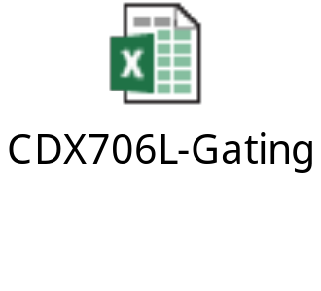
{R06 PRO.HF3} Open P2 issue list with risk evaluation
计数项:Labels | Fix version
Gating | FF27_R07.PRO | GF13_R07.PRO | 总计
Analysis |  | 10 | 10
Developing |  | 5 | 5
New |  | 3 | 3
Verification | 1 | 2 | 3
总计 | 1 | 20 | 21
Notes:
Add P1 weekly burn down chart

Slide 5
{R06 PRO.HF3} 性能测试状态
1.该版本的性能优化：
1）706L radio在R06版本上主要做了一些布局层级优化、异步加载布局和优化冗余逻辑；
2）看FM温启动视频，从手指开始抬起，到界面完成显示稳定是有600ms时间，去掉了app默认的200ms渐变动画。
Notes:
Add P1 weekly burn down chart

Slide 6
{R06 PRO.HF3} 性能测试状态
序号 | 影响因素 | 权重 | SPEC | Reference | R05 | R05.1.HF1 | R06 | 偏差 | 分析
1 | Power on第一帧动画播放 | 1 | 5s | 7s | 7.80 | 14.10 | 13.77 | -2.39%
2 | Power on Launcher界面可见 | 1 | 12s | 15.8 | 23.60 | 23.25 | 23.19 | -0.26%
3 | Power on优先蓝牙重连完成 | 1 | 12s | 14.2 | 16.33 | 4.88 | 3.79 | -22.44%
4 | Power on车机网络时间同步完成 | 0.5 |  | 9.2 |  | 20.29 | 18.23 | -10.13%
5 | Power on开机动画过程中到Fast RVC显示 |  |  | 6s |  | 6.55 | 6.52 | -0.38%
6 | Power on Launcher启动后Fast RVC显示 | 2 | 2s | 6s |  | 1.58 | 1.05 | -33.37%
7 | Power on优先设备BT音源恢复 | 1 |  | 18.2 | 11.60 | 6.88 | 5.49 | -20.21%
8 | Power on车辆设置界面打开 | 0.5 | 3.5s | 7.2 | 3.97 | 3.85 | 2.89 | -24.72%
9 | Power on空调设置界面打开/快捷菜单上点击空调按钮可用 | 0.5 |  | 7.2 | 5.57 | 3.59 | 3.33 | -7.25%
10 | Power on SDM可用 | 0.5 |  | 7.2 | 4.02 | 4.90 | 3.77 | -23.15%
11 | SDM切换成功 | 0.5 |  | 7s |  | 3.42 | 4.44 | 29.86%
12 | Launcher显示到进入稳定运行阶段经过的时间 | 2 |  |  |  | 54.04 | 47.63 | -11.85%
13 | 系统稳定状态下Setting首次启动 | 0.5 |  | 1.5s |  | 1.07 | 0.97 | -8.85%
14 | 系统稳定状态下蓝牙音乐首次启动 | 1 |  | 1.5s |  | 3.80 | 1.61 | -57.66%
15 | 系统稳定状态下FM首次启动 | 1 |  | 1.5s |  | 3.16 | 1.04 | -66.97%
16 | Setting热启动 | 1 |  | 200ms |  | 0.45 | 0.47 | 3.70%
17 | 蓝牙音乐热启动 | 1 |  | 200ms |  | 0.96 | 0.75 | -21.93%
18 | FM热启动 | 1 |  | 200ms |  | 1.10 | 0.48 | -56.33%
19 | air conditioner热启动时间 | 0.5 |  | 200ms |  | 0.27 | 0.282 | 6.15%
20 | 蓝牙电话冷启动时间 | 0.5 |  | 12s |  | 11.82 | 9.34 | -20.94%
21 | 蓝牙电话热启动时间 | 0.5 |  | 200ms |  | 0.20 | 0.40 | 100.00% | 上个版本使用的测试手机不支持专辑图片和播放列表，这个版本多了专辑图片和播放列表，所以热启动加载时间不一样（加上渐变动画200ms）
22 | 投屏冷启动时间 | 0.5 |  | 2s |  | 1.96 | 2.33 | 19.21%
23 | 紧急呼叫冷启动时间 | 0.5 |  | 2s |  | 1.10 | 0.17 | -84.90%
84 | 精简屏幕冷启动时间(系统已启动2min后测试) | 0.5 |  | 2s |  | 1.96 | 0.66 | -66.62%
25 | 精简屏幕热启动时间(系统已启动2min后测试) | 0.5 |  | 200ms |  | 0.90 | 0.57 | -36.99%
Notes:
Add P1 weekly burn down chart

Slide 7
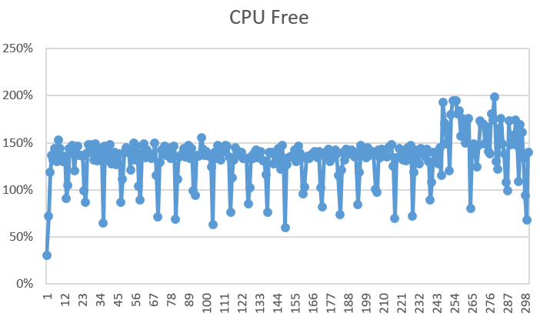
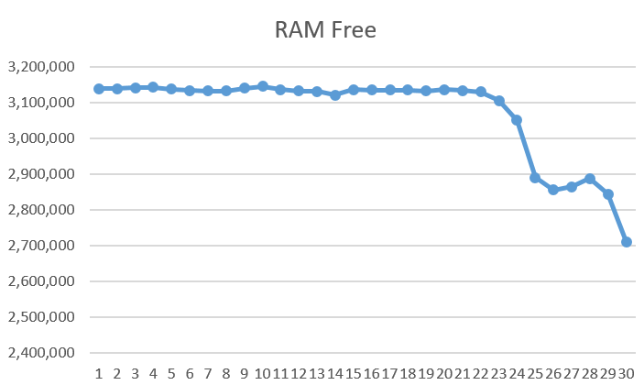
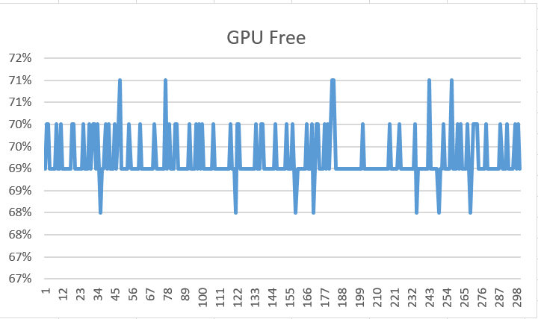
{R06 PRO HF3} 性能状态
序号 | 影响因素 | 权重 | R05 | R05.HF1 | R06 | 偏差
1 | 8小时Monkey测试-设置 （com.desay.setting） | 0.5 |  |  | 0 | Pass
2 | 8小时Monkey测试-蓝牙音乐（com.desaysv.mediaplayer） | 0.5 |  |  | 0 | Pass
3 | 8小时Monkey测试-蓝牙电话 （com.desay_svautomotive.bluetoothtel） | 0.5 |  |  | 0 | Pass
4 | 8小时Monkey测试（其他所属应用） | 0.5 |  |  | 0 | Pass
5 | 24小时Monkey测试中的CPU Free | 1 | 23.97% | 24.31% | 122.00% | Pass
6 | 24小时Monkey测试中的RAM Free | 1 | 1042904K | 1131803K | 632407.8 | Pass
7 | 24小时Monkey测试中的GPU Free | 1 | 67.88% | 72.64% | 92.00% | Pass
8 | 24小时Monkey中的ANR次数 | 1 |  |  | 0 | Pass
9 | 24小时Monkey中的Crash次数 | 1 |  |  | 0 | Pass
10 | 24小时Monkey中内存泄露进程数 | 1 |  |  | 0 | Pass
CPU Free
RAM Free
GPU Free
Notes:
Add P1 weekly burn down chart

Slide 8
{R06 PRO.HF3} OTA测试状态
Title: | Verification Test Report For OTA
Function Name | Total Test Case | Passed Test Case | Failed Test Case | Percentage of Test Completion: | Test Cases Pass Percentage:
TC_SOC_OTA | 86 | 76 | 0 | 88.37% | 100.00%
TC_MCU_OTA | 74 | 71 | 0 | 95.95% | 100.00%
TC_MCU_USB | 66 | 65 | 0 | 98.48% | 100.00%
TC_SOC_USB | 66 | 65 | 0 | 98.48% | 100.00%
Total | 292 | 277 | 0 | 94.86% | 100.00%
Test Summary Description
pass
Notes:
Add P1 weekly burn down chart

